Slide 1


Title: Songs Analysis Dashboard Presentation Subtitle: Analyzing YouTube Song Video Trends and Engagement
By Raunak Saini
Batch Name: MIP-DA-10
Profile:- Data Analysis Intern

Slide 2


PROJECT OVJECTIVE: Leverage data analytics to gain a comprehensive understanding of YouTube song video performance
IMPOTANCE: Optimization of Content Strategy, Enhanced Audience Engagement, Effective Timing.
Key Points: Analyze YouTube song video metrics.
Identify temporal trends and peak publishing times.
Explore factors influencing user engagement.
Deliver actionable insights for content creators.

Slide 3
PROBLEMS
Data Overload: The vast amount of YouTube data makes it challenging to extract meaningful insights without advanced analytics.
Inconsistent Metrics: Variability in engagement metrics across different channels and videos complicates performance comparisons.
Temporal Fluctuations: Rapid changes in viewer behavior and platform algorithms create difficulties in identifying consistent trends.
Limited Visibility: Without a consolidated view, stakeholders struggle to identify actionable strategies to enhance video performance.

Slide 4
PROJECT DETAILS
video_id: Unique identifier for each YouTube video.
channelTitle: Title of the YouTube channel publishing the song.
title: Title of the YouTube song video.
description: Description provided for the YouTube song video.
tags: Tags associated with the YouTube song video.
publishedAt: Date and time when the YouTube song video was published.
viewCount: Number of views received by the YouTube song video.
likeCount: Number of likes received by the YouTube song video.
favoriteCount: Number of times the YouTube song video has been marked as a favorite.
commentCount: Number of comments posted on the YouTube song video.
duration: Duration of the YouTube song video.
definition: Video definition or quality (e.g., HD, SD).
caption: Availability of captions for the YouTube song video.

Slide 5

DATABASE USED : MICROSOFT POWER BI Desktop

Slide 6
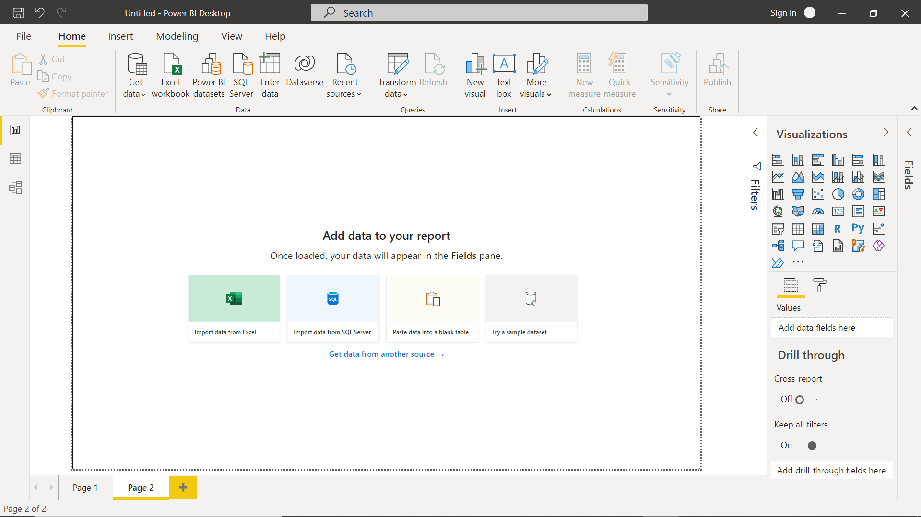
POWER BI DESKTOP INTERFACE

Slide 7
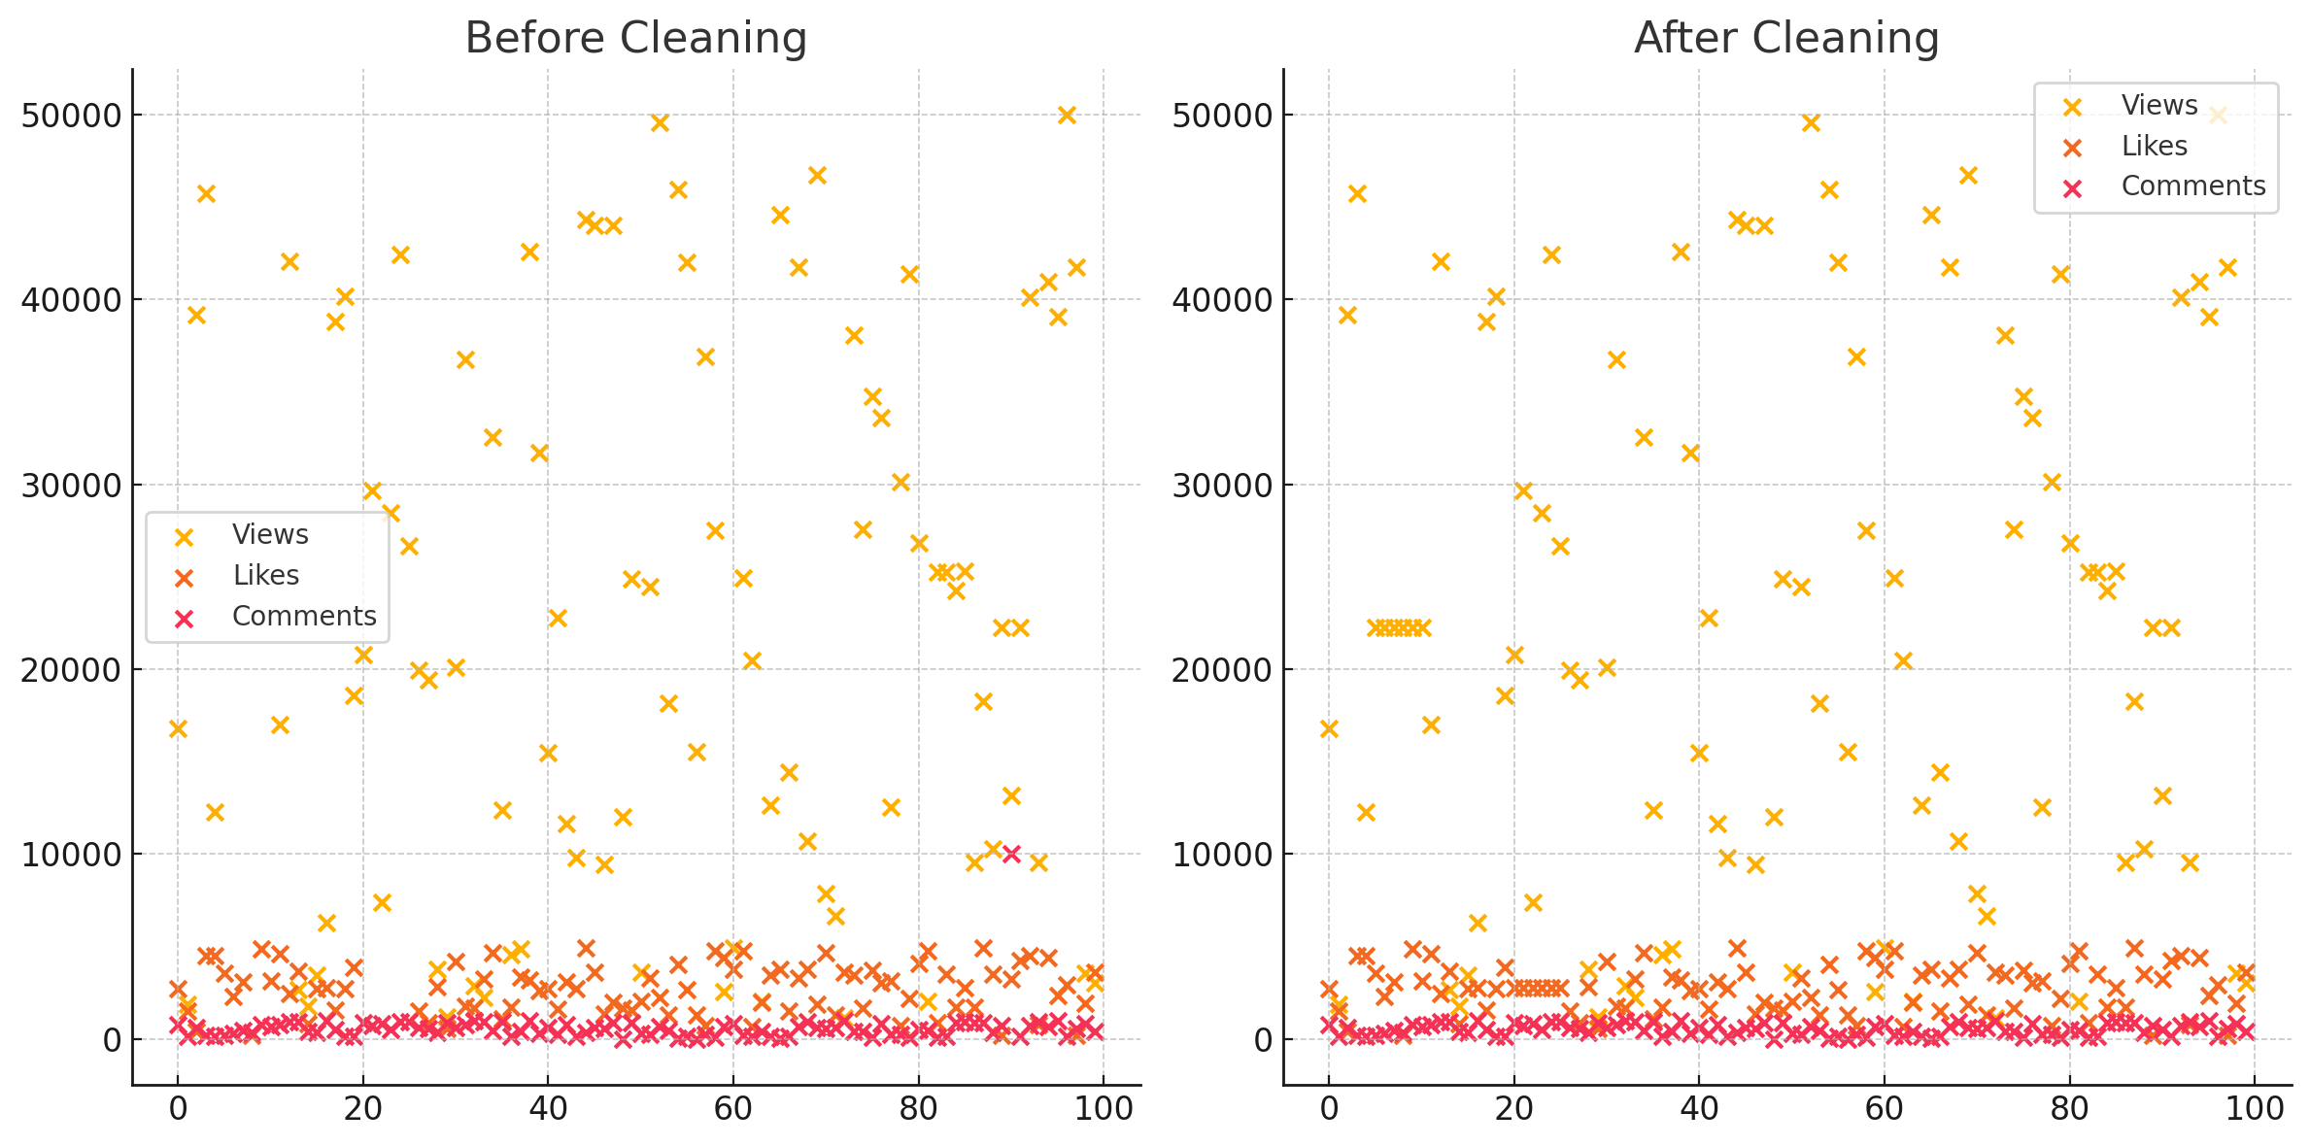
LTES START WITH QUESTIONS:
Q1) Data Cleaning and Preparation:
- Clean and preprocess the dataset, handling missing values or outliers.
- Convert relevant columns to appropriate data types.
Data Cleaning:
Handle Missing Values: Identified and addressed missing values to ensure dataset completeness and accuracy.
Remove Outliers: Detected and removed outliers to maintain data integrity and improve analysis reliability.

Slide 8
Q2. Exploratory Data Analysis (EDA):
- Explore patterns and distributions in view counts, like counts, and comments.
- Identify trends in the popularity and engagement of YouTube song videos.
1. Explore Patterns and Distributions:
View Counts:
Analyzed the distribution of view counts to understand how often videos reach different viewership levels.
Identified outliers and significant peaks to determine which videos garnered exceptional attention.
Like Counts:
Examined the distribution of likes to evaluate audience approval and engagement.
Investigated the relationship between likes and views to identify highly appreciated content.
Comments:
Explored the distribution and volume of comments as a measure of audience interaction.
Analyzed how comments correlate with views and likes to gauge overall engagement levels.
2. Identify Trends in Popularity and Engagement:
Temporal Trends:
Analyzed how view counts, likes, and comments fluctuate over time to identify seasonal patterns and peak periods.
Assessed the impact of posting times on video popularity and engagement metrics.
Content Trends:
Investigated the types of content (genres, keywords) that consistently perform well in terms of views, likes, and comments.
Identified recurring themes or attributes of top-performing videos to inform future content strategies.

Slide 9
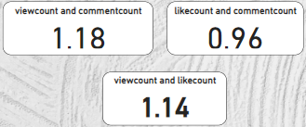
Q3) Content and Channel Analysis:
- Analyze the distribution of videos across different channels.
- Identify popular tags and their correlation with view counts.
Distribution of Videos Across Different Channels:
Channel Distribution:
Analyzed the number of videos posted by various channels to understand content output.
Identified top channels by video count and their contribution to the dataset.
Performance Comparison:
Compared the average view counts, likes, and comments across different channels to identify high-performing channels.
Highlighted channels with consistently high engagement metrics.
Popular Tags and Their Correlation with View Counts:
Tag Analysis:
Identified frequently used tags in video descriptions and titles.
Analyzed the correlation between popular tags and view counts to understand which tags drive higher viewership.

Slide 10
Q4) Temporal Trends:
- Explore how YouTube song video metrics vary over time.
- Identify peak publishing times and their impact on engagement.
Temporal Trends:
Insights:
Initial Surge: Many videos experience a surge in views and engagement shortly after release.
Sustained Engagement: Some videos maintain a steady stream of views and interactions over time, indicating lasting popularity.
Declining Interest: Others might see a rapid drop-off after the initial interest wanes.
Identify peak publishing times and their impact on engagement:
Insights:
Optimal Times: Identify specific times and days when videos tend to receive higher views and interactions.
Audience Behavior: Understand when your target audience is most active on YouTube.
Publishing Strategy: Develop a publishing schedule that aligns with peak engagement periods to enhance visibility and interaction.

Slide 11
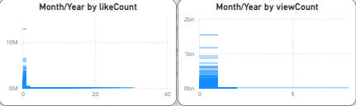
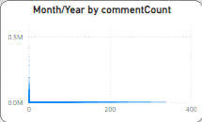

Q5) User Engagement Insights:
- Investigate relationships between likes, comments, and views.
- Identify factors influencing user engagement with YouTube song videos.

Slide 12
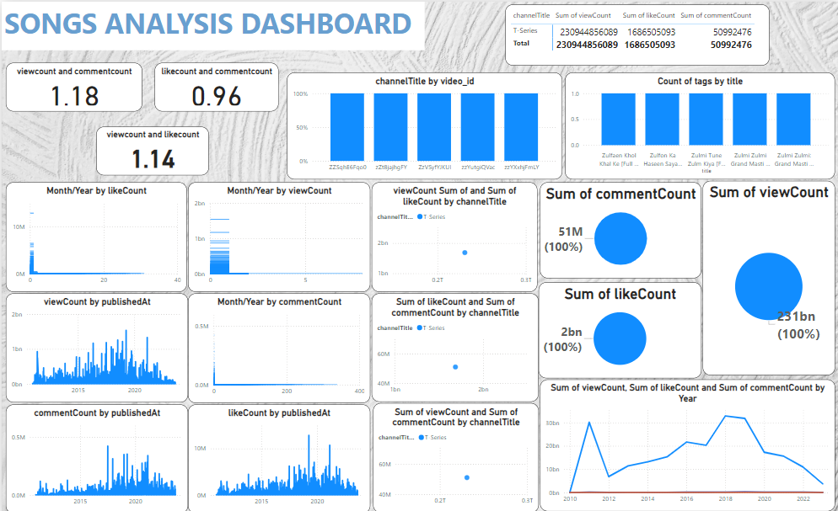
This is my dashboard

Slide 13
THANK YOU

